Slide 1
Sentiment Analysis of Amazon Echo Reviews
Comprehensive Report with Visualizations

Slide 2
SNA Project Presentation
By: Kashish Jalan (219309158)
Department: Data Science And Engineering
Submitted To: Mrs. Aprna Tripathi

Slide 3
Table of Contents
3
Synopsis
8
Results And Visualizations
4
Introduction
9
Conclusion
5
Data Collection
10
Future Directions
6
Algorithmic Arsenal
7
Methodology

Slide 4
Synopsis
The project focuses on analyzing customer sentiments for Amazon Echo reviews. Using three machine learning algorithms—Logistic Regression, Gradient Boosting, and Naive Bayes—the reviews are classified into positive, negative, or neutral categories. A preprocessing pipeline refines the dataset, and compelling visualizations, such as pie charts, word clouds, and heat maps, make the findings accessible.
SNA can reveal connections between sentiment types and frequently co-occurring words, highlighting patterns in customer concerns or praises.

Slide 5

Introduction
Sentiment analysis deciphers customer emotions, offering valuable insights into their experiences with the Amazon Echo. This study employs three machine learning models and augments results with preprocessing and visualization tools. The aim is to provide actionable insights for product improvement.
SNA identifies clusters of reviews with similar sentiments, helping to discover communities of users who share common opinions.

Slide 6

Data Collection
The dataset comprises meticulously curated Amazon Echo reviews labeled with sentiments (positive, negative, neutral). Preprocessing removed noise like HTML tags and special characters, ensuring a clean dataset for robust analysis.
SNA helps map relationships between reviewers, such as identifying recurring customer feedback patterns or clustering similar sentiments based on themes.

Slide 7
Algorithmic Arsenal:
Three machine learning models were used:
Logistic Regression: Achieved an accuracy of 93%, excelling in binary classification tasks.
Gradient Boosting: Captured nuanced patterns, with an accuracy of 92%.
Naive Bayes: Efficient for text classification, also achieving 92% accuracy.
SNA complements these algorithms by showing how topics and sentiments influence each other in a network of customer reviews.

Slide 8

Methodology
The text preprocessing pipeline removed noise and transformed data into numerical formats using Count Vectorization. The dataset was split into training and testing subsets, and model performance was measured using standard metrics like accuracy, precision, recall, and F1-score.
SNA visualizes the interconnections between terms in the reviews, revealing influential words or phrases associated with specific sentiments.

Slide 9

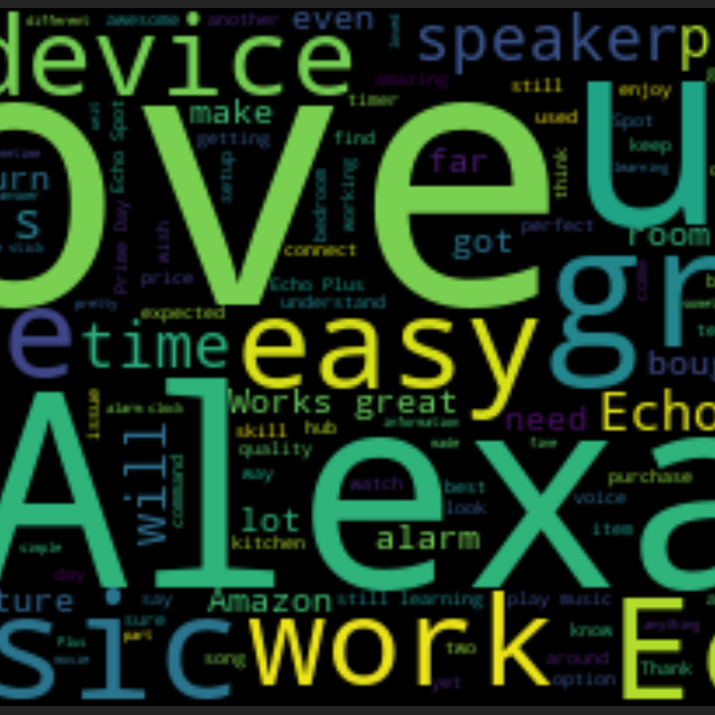
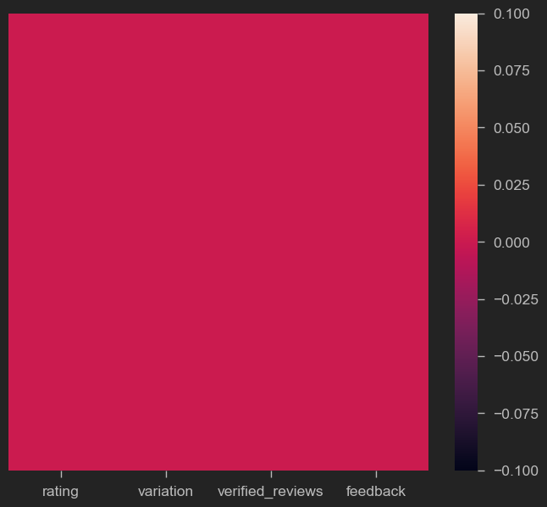
Results and Visualizations
Pie Charts
Word Clouds
Heat Maps
Show sentiment distribution across categories.
Highlight frequently used terms in each sentiment.
Visualize algorithm performance in sentiment classification.

Slide 10
Conclusion
Logistic Regression outperformed the other models, while Gradient Boosting and Naive Bayes demonstrated strong performance. Visualizations provided intuitive insights, and the analysis highlights the potential of machine learning and SNA to understand customer sentiments effectively.
SNA uncovers sentiment-driven communities and identifies pivotal words or topics influencing customer perceptions.

Slide 11
Future Directions
Future research could explore advanced NLP techniques like deep learning and expand datasets to diverse demographics. Interactive visualizations and SNA will further enrich insights and help identify hidden patterns in sentiment data.
SNA can guide future research by uncovering evolving themes, tracking changes in sentiment trends over time, and identifying influencers or opinion leaders in the review network.

